Slide 1

Deployment on Heroku
Mark Kimutai Kitur
LISUM33
kiturmark@gmail.com
2ˆnd June 2024

Slide 2
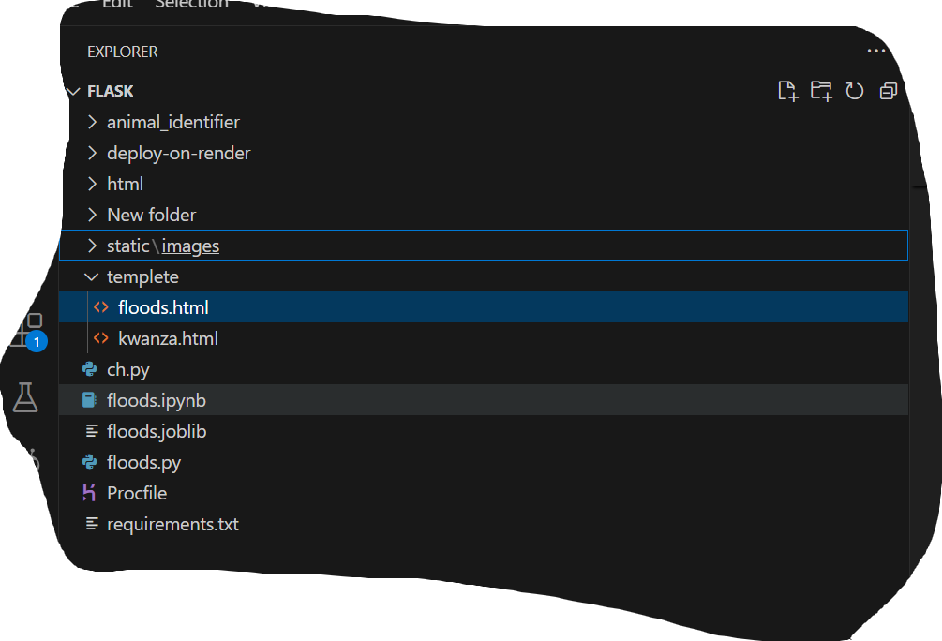
STEP 1
Getting files ready
model.joblib
flask app(floods.py)
HTML
Profile
requirements.txt

Slide 3
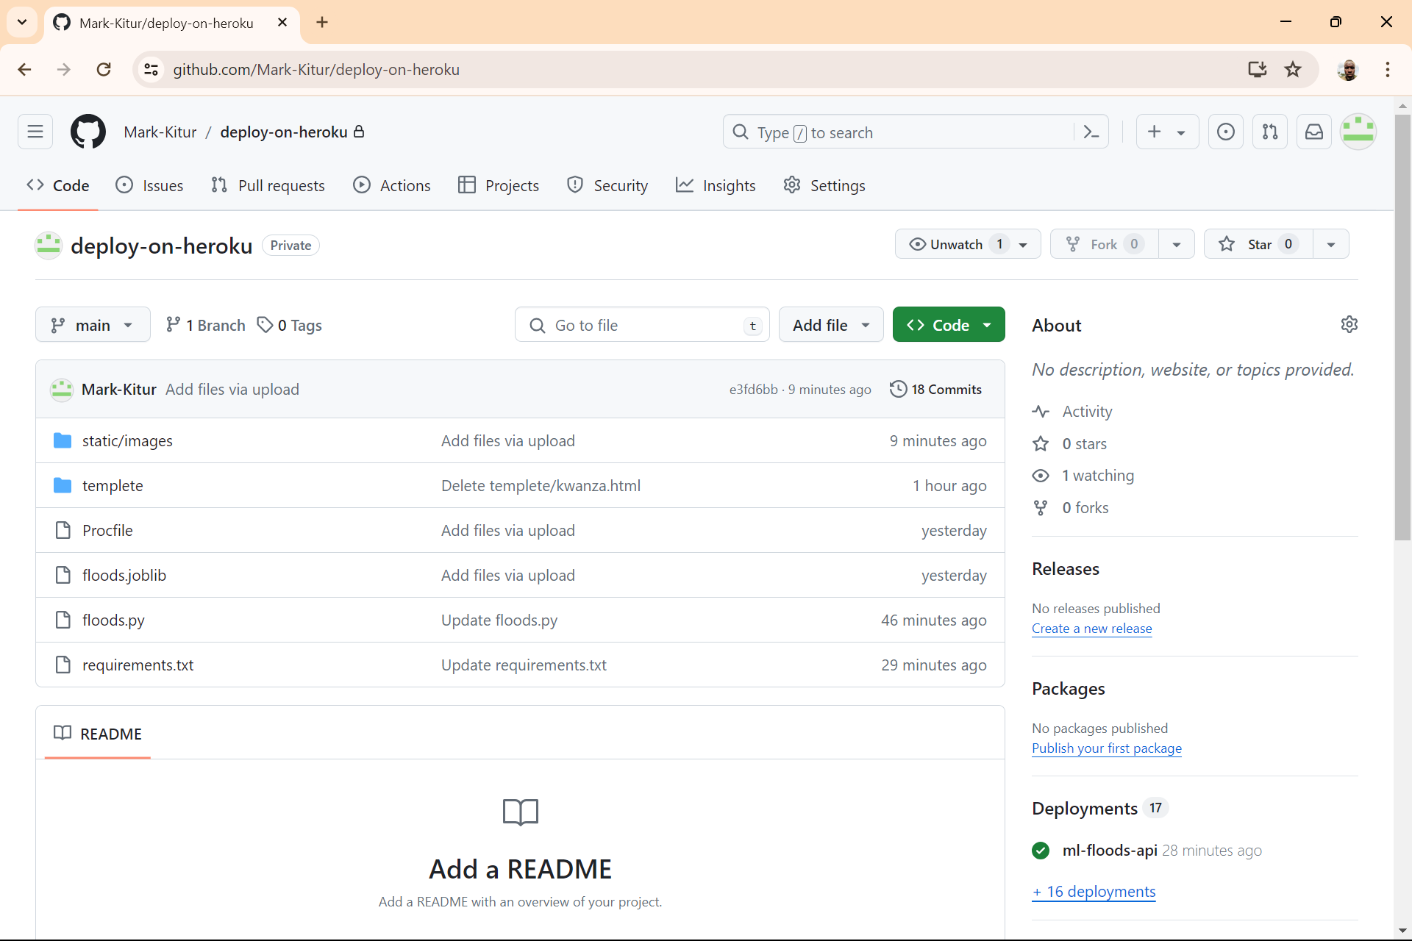
STEP 2
Upload to Github

Slide 4
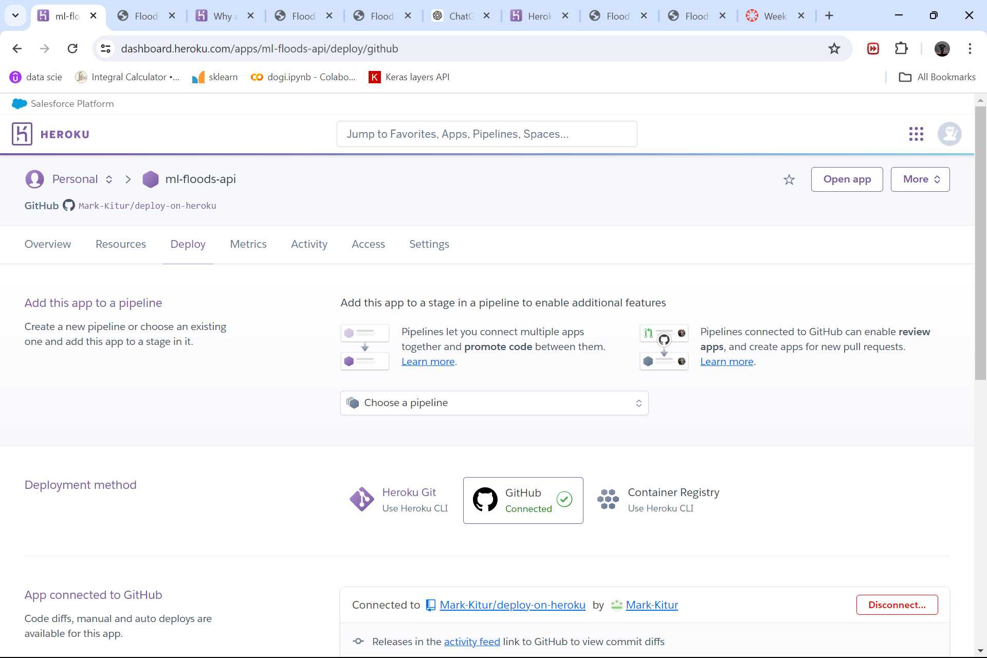

STEP 3
Open an account on Heroku and connect to GitHub
Then connect to the repository that contains the files.
Click on deploy

Slide 5
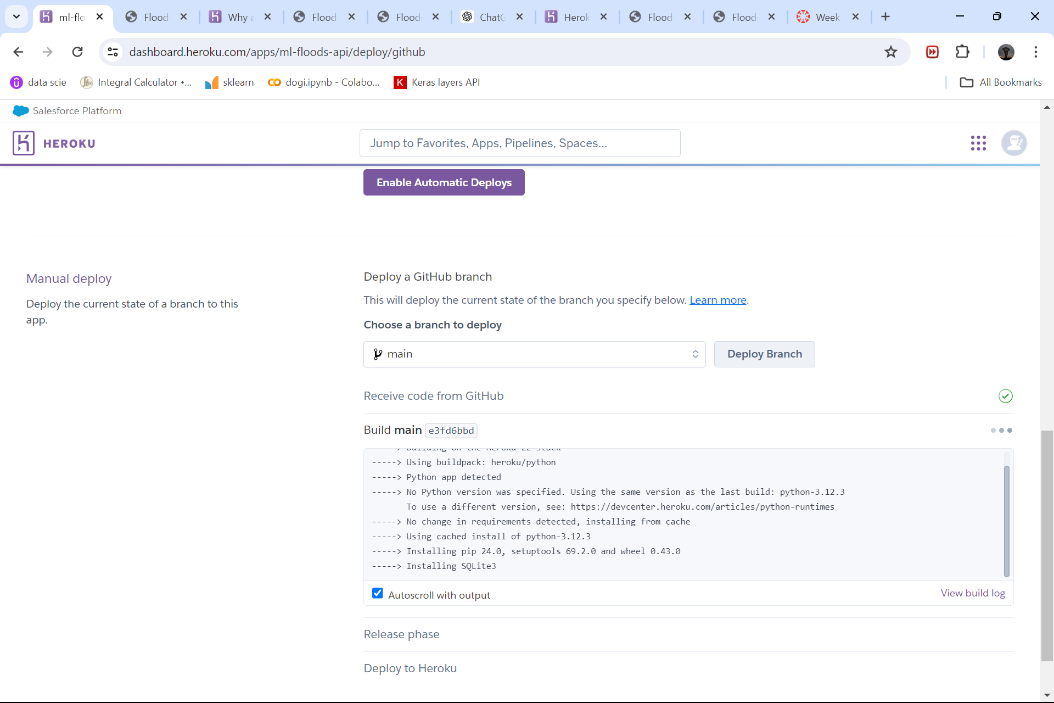
deploying

Slide 6
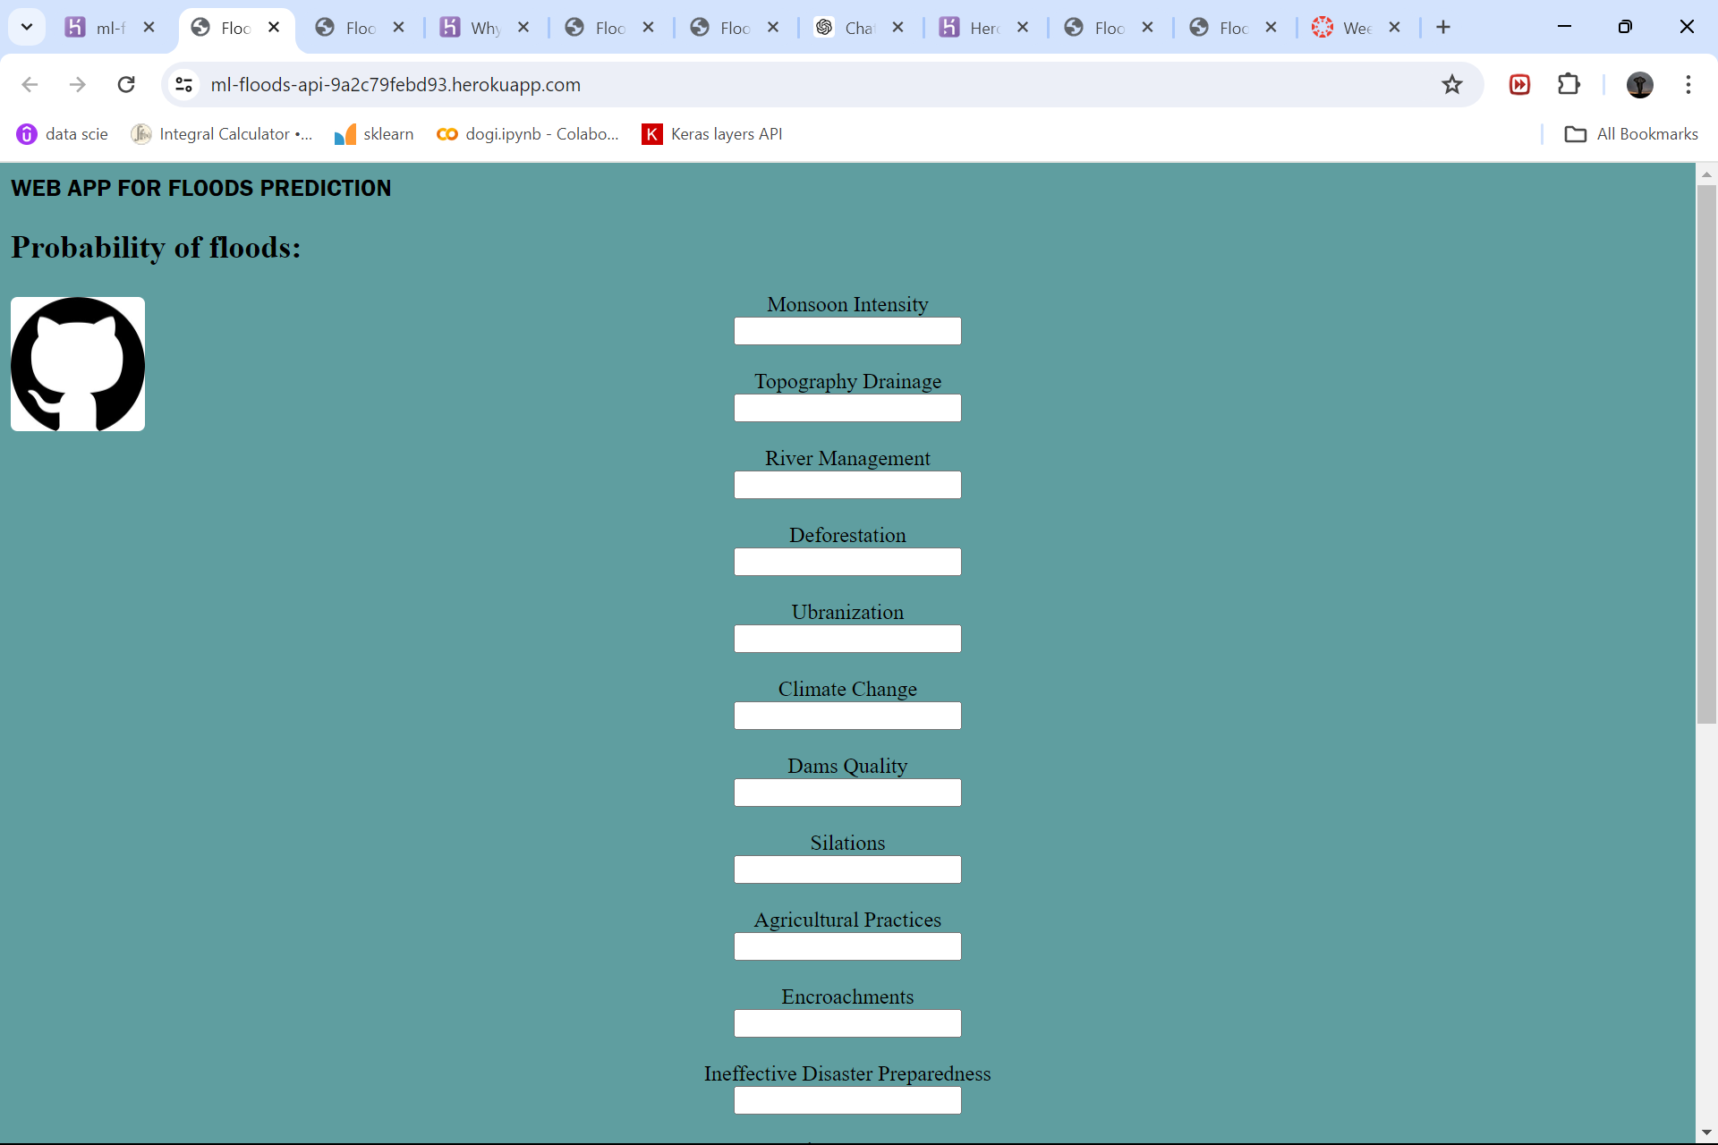
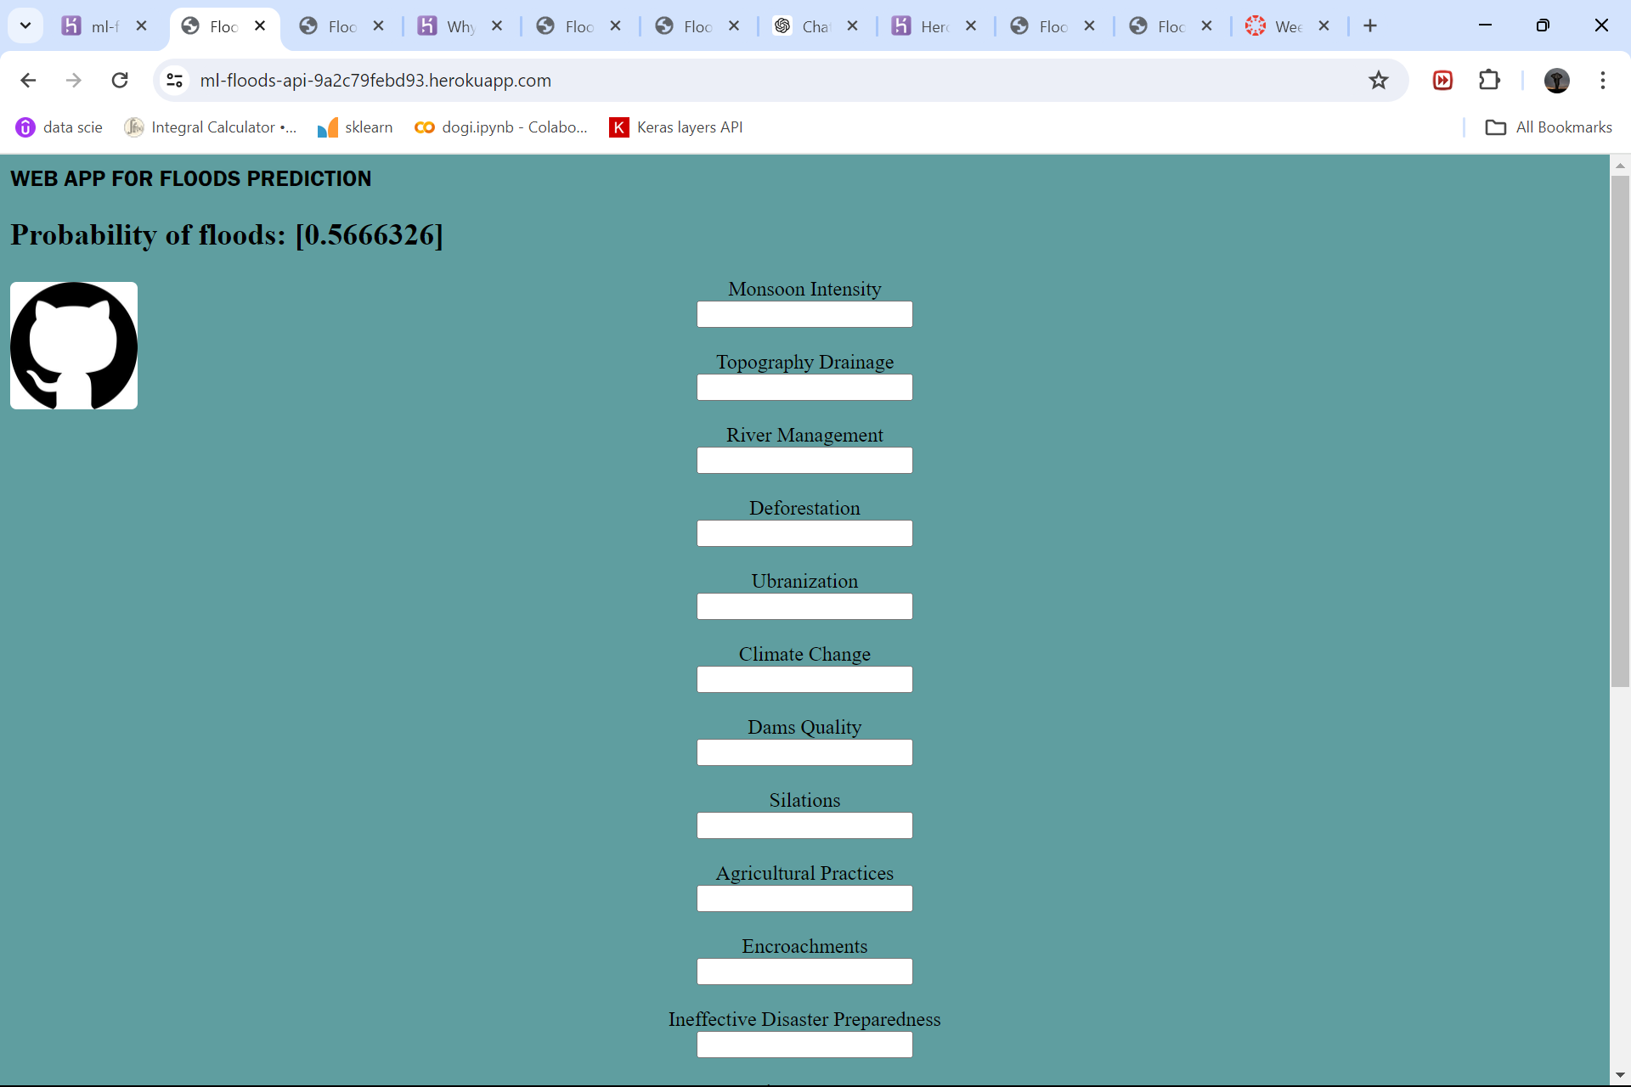
Execution

Slide 7
Thank you
https://ml-floods-api-9a2c79febd93.herokuapp.com/

